Slide 1
Make a User persona analysis reaserch on Facebook and Linkedin
ASSIGNMENT
Made by: Yusuf j
KTC Hubli

Slide 2
What is a user persona?
User personas are archetypical users whose goals and characteristics represent the needs of a larger group of users. Usually, a persona is presented in a one or two-page document. Such 1–2-page descriptions include behavior patterns, goals, skills, attitudes, and background information, as well as the environment in which a persona operates. Designers usually create user persona template templates, which include a few fictional personal details to make the persona a realistic character (e.g. quotes of real users), as well as context-specific details (for example, for a banking app it makes sense to include a persona’s financial sophistication and major expenses).

Slide 3
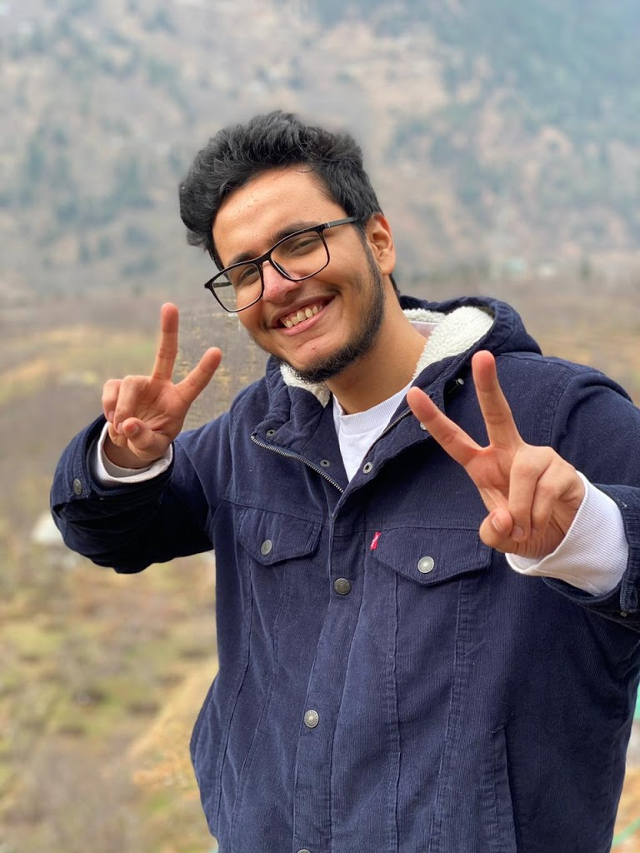
User persona on Triggered Insaan
Nischay Malhan | Triggered Insaan is a very popular Indian Youtuber known for his roasting videos on youtube. He also runs a YouTube channel where he uploads Interesting and funny Videos. He is also an Indian Youtuber and Actor. Mostly He shares his fashionable outfits and Video clips over his own Instagram,Facebook account.

Slide 4
He was born on 14 November 1995, in Delhi, India in a Hindu family and now in 2022, he is 26 years old. He is an Indian by Nationality. The full name of Triggered Insaan is Nischay Malhan and people call him Triggered Insaan. He is Hindusim by his religion and his zodiac sign is Scorpio.
Triggered Insaan looks very good and also he has a very amazing hairstyle. He has a huge following on Social Media. Nischay Malhan (Triggered Insaan) has over 4.6M Followers on his Instagram account and over 16.5 Million Subscribers on his Youtube Channel.

Slide 5
The height of Nischay Malhan (Triggered Insaan) is “185 cm” and his Weight is “65 kg” He has a Heavy Body and his Body Measurements are 42-34-14. He got Black eyes and Black Hair.
He also has a gaming channel called Live Insaan where he uploads gaming Videos like GTA, Minecraft And He Used To Upload Getting Over It. He is credited for the popularisation of the famous Hindi dialogue "Oh Bhai... Maaro Mujhe Maaro! [Oh Man! Beat Me, Beat Me!].

Slide 6
Life
Nischay was born in Delhi.He has an older sister, Prerna Malhan, she also has a youtube channel named Wanderer's hub. He also has a younger brother, Abhishek Malhan, he has two channels, Fukra Insaan, and Fukra insaan Live . He used to be an intelligent student in school and would always come third or second (except 7th standard where he came first) in his standard every year. After passing tenth standard, he became so obsessed due to lack of physical labor that he was in a complete depression for the next two years (eleventh and twelth standard). In his hostel during his college life, he credits his roommate to help him come out of the severe depression. He completed the Engineering Degree, and went on to work at a job, but he didn't like his manager who taunted him since he would watch videos of other YouTubers while eating during the lunch. In the first job, his boss fired him in 3 months.

Slide 7
YouTube Career
while doing his second job, he used to record videos late night, and when he was around 100k subs, he left his job and became a full-time YouTuber. After that, he continued to post videos on YouTube and gradually became a successful and established YouTuber.
Before coming to the name Triggered Insaan, he first named his channel Yes-Yes-Bhai. That is because his name Nischay translates to obviously in English. After that, he named it It's Nischay. But he thought that people won't be able to pronounce his name properly because in Hindi, his name is pronounced "Nishchay", but the priest who named him said that two h's in his name would be odd and changed it to one h. and he changed it to Triggered Insaan. He would watch another YouTuber who had the word "Insaan" in their name and the word Triggered came from the fact that his father would be easily angry on him or get Triggered. This was the decision of his final name.

Slide 8
Controversy
Net Worth of Nischay Malhan
The Triggered Insaan earns a good amount of money. Currently, in 2022 his net worth is $ 3.8 Million, and his main income source is YouTube & Acting.
Many criticize Nischay for being copying style of CarryMinati. Now he is a good friend of carryminati.

Slide 9
Hobbies & Interests
Hobbies of Nischay Malhan are Bodybuilding & Traveling. He also loves to Play Games and Watch funny videos.
Favorite Food: | Dry Fruits
Favorite Actor: | Hrithik Roshan
Favorite Actress: | Disha Patani
Favorite Movie: | Bhaubali 2
Favorite Drink: | Lemon Juice
Favorite Subject: | Physics
Favorite Animal: | Horse
Favorite Website: | Instagram
Favorite Color: | White
Favorite Car: | Lamborghini
Favorite Singer: | Guru Randhawa
Hobbies: | Travelling & Gaming

Slide 10
Collaboration
Triggered Insaan first started collaborating with Mythpat on April 26, 2020, in the game Grand Theft Auto 5, where they played online together completing fictional missions. The series was successful, and had two more episodes - 3 and 4.
On June 14, 2020, Mythpat uploaded a video titled "PHOTOSHOPPING INDIAN YOUTUBERS", where he messed with the faces of different Indian YouTubers, which included Nischay. Mythpat had drawn a pineapple design across his face, and after showing it to Nischay, he conveyed a thumbs up. Later in the game of Minecraft, Mythpat mysteriously lost his pet Llama. Involving Nischay in it, the llama was "confirmed" to be "kidnapped" by Nischay, and this gave rise to a brand new series.

Slide 11
Trivia
Nischay did his engineering in ECE from IIITDI ndraprastha Institute of Information Technology Delhi (IIIT-Delhi).
He had been a fan of PewDiePie, but stopped supporting him after his "Bitch Lasagna" diss-track on T-Series.
Nischay has also reacted to stupid hacks shown by 5-Minute Crafts and Troom Troom India.
In August 2020, Nischay live-streamed games for 24-hours straight for a fundraising on flood-relief for the states of Assam and Bihar.
In August 2021, Nischay revealed in his live-Stream that his favourite youtuber is KSI.
His Ex-girlfriend name was kaju katli(not revealed real name).

Slide 12
Some Facts of Nischay Malhan
Does Nischay Malhan, Consume Alcohol? No
Does Nischay Malhan, Smoke Cigarettes? No
Nischay Malhan was born on 14 November 1995, in Delhi, India.
He is a very good Driver.
Nischay Malhan goes to GYM daily.
The famous name of Nischay Malhan is Triggered Insaan.
He is a Vegetarian.
Nischay Malhan Net Worth $ 3.8 Million USD in 2022.
Nischay Malhan has over 4.6M Instagram Followers.
Nischay Malhan has over 16.5M Subscribers on his Youtube Channel.

Slide 13
THANKYOU

